Slide 1
Tomorrow's Photovoltaic Solar Cells
John C. Bean
Outline
Quick review of PV science / NREL's scorecard on Best Research PV Cells
Thin-film cells: Potentially low cost, but now often less efficient OR shorter-lived OR toxic
Multi-junction / Tandem cells: Using different parts to absorb different colors of sunlight
  Layering multiple solar cells atop on another: The more common approach
  Tuning different quantum-dots to different colors: An emerging approach
Luminescent Solar Concentrators: Capturing / converting sunlight into one PV-friendly color?
  Via quantum-dots or dye molecules embedded in thin transparent plastic layers
  The possibility of skimming off unwanted colors trying to pass through windows
    Such as unwanted infrared (i.e., summer heat) and/or destructive ultraviolet
Thermophotovoltaics: Converting waste heat from engines, factories . . . into PV power?
  Using weird manmade "metamaterials," including "photonic crystals"
(Written / Revised: November 2019)

Slide 2
Tomorrow's Photovoltaic Solar Cells
Today's Solar Cells (pptx / pdf / key) introduced the science of PV solar cells
  And then described the materials & types of cells producing today's PV power
This note set instead explores a long list of contenders for PV cell of tomorrow
  Some seek cost reduction through the use of cheaper materials
  Many strive for more efficient conversion of sunlight's full range of colors
Motivating the latter: SINGLE photons give ALL of their energy to SINGLE electrons
  Each electron liberates itself with some of that energy (=> PV electricity)
  But it uses any excess energy to whiz about, ricocheting off atoms,
    kicking them into vibration, wasting that excess photon energy as heat
To fully appreciate these challenges, a review of my earlier PV note set is in order
An Introduction to Sustainable Energy Systems: WeCanFigureThisOut.org/ENERGY/Energy_home.htm

Slide 3
A Review of Solar Cell Science in 10 Slides
(See the my Today's Solar Cells (pptx / pdf / key) note set for greater / more palatable detail)
An Introduction to Sustainable Energy Systems: WeCanFigureThisOut.org/ENERGY/Energy_home.htm

Slide 4
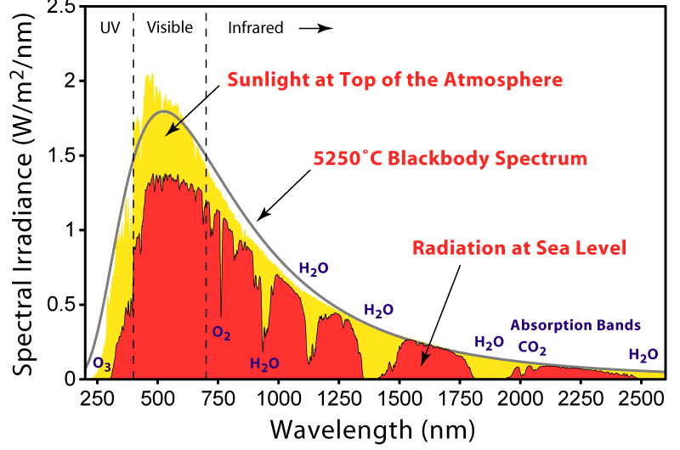
PV cells TRY to efficiently convert sunlight of ALL colors into electricity
Here are plots of sunlight intensity (as power flow / area / increment of wavelength)
  at both the top and bottom of the earth's atmosphere:
Wavelength
Photon Energy
5 eV
2 eV
1 eV
0.5 eV
UV
Vis
Infrared

Slide 5


Those colors interact very differently with matter:
Infrared
Visible
UV
Liberates electrons from bonds
IFF the material has an electron liberation energy ≤ light energy
Liberates electrons from bonds
but gives them so much excess energy that they ricochet all around
Excess energy is lost as struck atoms start to vibrate (=heat)
Vibrates a few atoms
But most light just
passes right through

Slide 6
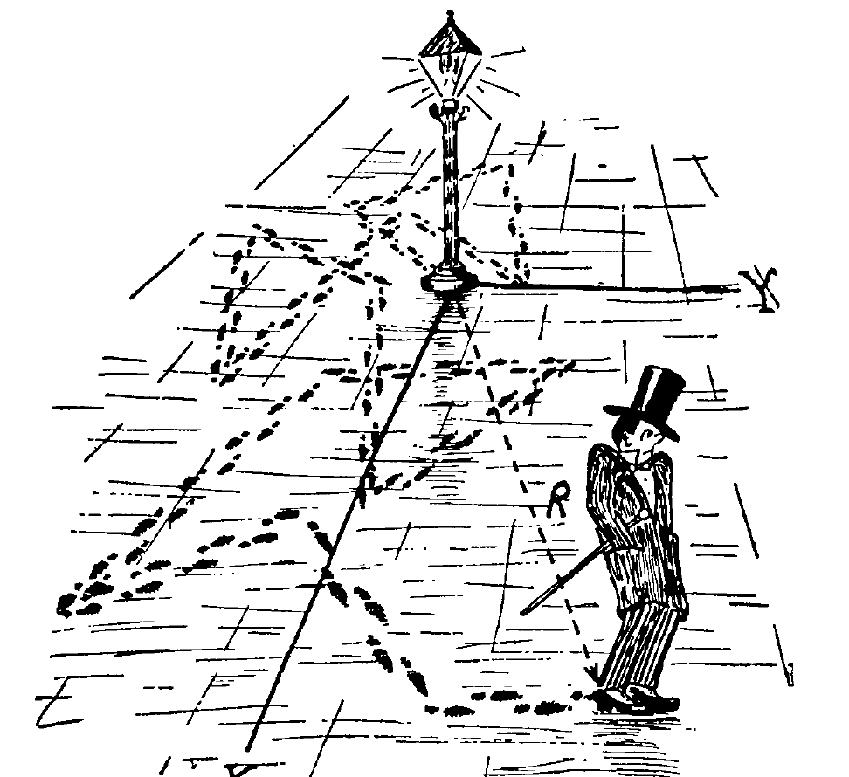
But mere liberation of electrons is not enough!
Liberated electrons (leaving behind "holes" in bonds) are subject to no driving force
And thus wander randomly = Diffusion
  Diffusion is analogous to "the drunkard's walk"
    Depicted here, a drunk bouncing off light posts:
But PV cells have two types of wandering drunks: electrons and (bond) holes
  And these unique types of drunks can "annihilate" one another
    That is, a wandering electron can just fill the hole (in a bond) => zip!
To create a net flow (=> electricity) a photovoltaic cell MUST include a cliff
  Over which the "electron drunks" will fall (and the "hole drunks" ascend)
Or the way I was first taught it: Electrons ~ Ball bearings (which fall DOWN)
Holes ~ bubbles (which FLOAT up)
Figure: http://www.sos.siena.edu/~jcummings/teaching/astronomy/lectures/reveal.js-master/ch10.html#/

Slide 7
The solar cell's selective "cliff" is provided by an electric field
Which WE do NOT have to create by applying an external battery or power supply!
Instead, electric fields are naturally generated at the junction between two materials
  But only if electrons choose to shift from one material to the another
THIS OCCURS WHEN: Material at right has electrons in energy levels higher than
  empty levels in material at left => Electron moves to new lower energy home!
Negative charge displacement ALSO creates an electric field at the junction

Slide 8
Which, via careful materials selection, gets us to this point:
Sunlight in
Electric Field
Light-liberated electron
(and bond hole) created
The Electric Field sorts things out, pushing holes left & electrons right => "electricity"
But only if drunkard's walk of light-liberated holes & electrons GETS them to the
electric field BEFORE they have recombined with one another!
If they recombine first, their energy is instead lost as heat (a.k.a. vibrating atoms)
So why use a thick layer that puts the field (cliff) so far away? (!)
Because light is not all absorbed (and converted to electrons + holes) at the surface
Strong light absorption requires tenths to tens of microns of material

Slide 9
With that necessarily thick layer, situation is more like this :
Sunlight in
Electric Field
Light-liberated electrons
(and bond holes) created
It is then REALLY IMPORTANT that freed electrons & holes do NOT recombine
before reaching the sorting electric field at the junction between the layers
Their average random walking survival distance is called their diffusion length
Diffusion length depends on the structure and purity of the material because:
Electrons & holes are drawn to impurities and flawed crystal bonds
Once together at such TRAPS, electrons & holes can easily recombine
So the purity and perfection of PV crystals is extremely important!

Slide 10
But looking more closely at the light photon's absorption by an electron:
Different cell materials have different electron liberation energies (= "Bandgaps")
1) Absorbing photon's energy, electron uses "bandgap" of it to climb out of a bond:
2) Any leftover energy propels electron madly through PV cell (=> "Butt-Kicking")
3) Struck atoms absorb that Butt-Kicking kinetic energy:
=> Atomic vibrations (= Heat) + Slowed down electron
Heat energy is NOT converted to electrical power!

Slide 11
Fate of absorbed light energy in materials having different bandgaps:
Energyphoton < Material's bandgap: Minimal absorption, zero electron liberation
Energyphoton = Material's bandgap: All of energy goes into electron liberation
Energyphoton > Material's bandgap: More & more energy wasted on Butt-Kicking
Cell with small "bandgap"
VIS
Cell with medium "bandgap"
VIS
Energy absorbed by solar cell
Cell with large "bandgap"
Butt Kicking
VIS
Energy absorbed by solar cell
Butt Kicking
Electron Liberation
Butt
Kicking
0 eV
Light's Energy
5 eV
Electron Liberation
Energy absorbed by solar cell
0 eV
Electron
Liberation
Light's Energy
5 eV
Gray Triangles => Energy lost to heating of the cell
0 eV
Light's Energy
5 eV

Slide 12
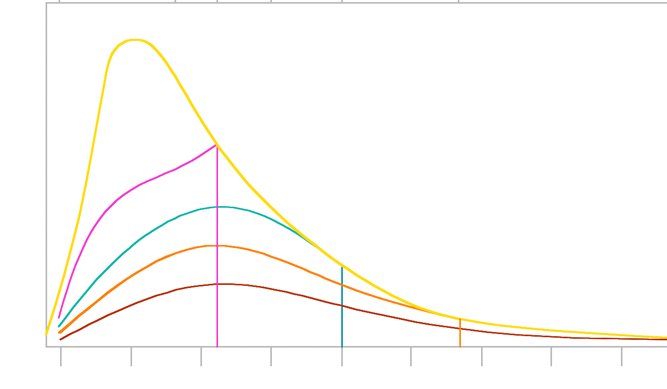
Electron liberation energy, alone, is reclaimable as PV electric output
Working out possible power output for a PV cell above the earth's atmosphere:
  Full available sunlight power = Area under yellow curve
  Net electron liberation power absorbed by small bandgap cell = Area under red curve
  Net electron liberation power absorbed by medium bandgap cell = Area under orange curve
  Net electron liberation power absorbed by large bandgap cell = Area under violet curve
<= Light's Energy (eV)
5 eV
2
1.5
1.25
1 eV
0.75 eV
0.5 eV
Sun's AM0 Spectrum
Light's Wavelength (nm) =>
250
500
750
1000
1500
2000
2500

Slide 13
Larger the area under a curve => Larger the possible electrical output
BIGGEST area comes between the curves for cells made of 1 eV & 1.5 eV materials
Material with a 1.3 eV bandgap could capture & convert ~ 35% of Sun's energy
This is called the Shockley-Queisser Limit after William Shockley & Hans Queisser
This ~ 35% efficiency limit is NOT due to poor solar cell engineering!
It is instead because:
We can ONLY CAPTURE that part of light energy liberating electron from bond,
REST of light energy is wasted giving that liberated electron a kick in the butt
All because a photon insists on giving ALL of its energy to a single electron
(even photons with enough energy to liberate multiple electrons!)

Slide 14
What are today's PV cells?
What emerging cells seek to replace them?

Slide 15
The U.S. National Renewable Energy Lab (NREL) tracks this via their annual:
Best Research Cell Efficiencies chart
As the name suggests, the chart records results achieved ONLY in a lab
  Even if only ONE lab in the whole world has ever achieved these results!
Meaning that many of these cells are not (and may never become) commercially viable
  But the chart does try to plot all credible contenders & their R&D progress
    Here is the 2018 chart in its full (and decidedly gory) glory: ¹
1) In the summer of 2018 I downloaded the following (then current) version of the NREL chart at:
https://www.nrel.gov/pv/assets/pdfs/pv-efficiencies-07-17-2018.pdf
This link has since died (as MANY U.S. Government links to renewable energy data have died under the Trump administration)
This alternative link was still functional as of late February 2019:
https://www.energy.gov/eere/solar/downloads/research-cell-efficiency-records

Slide 16
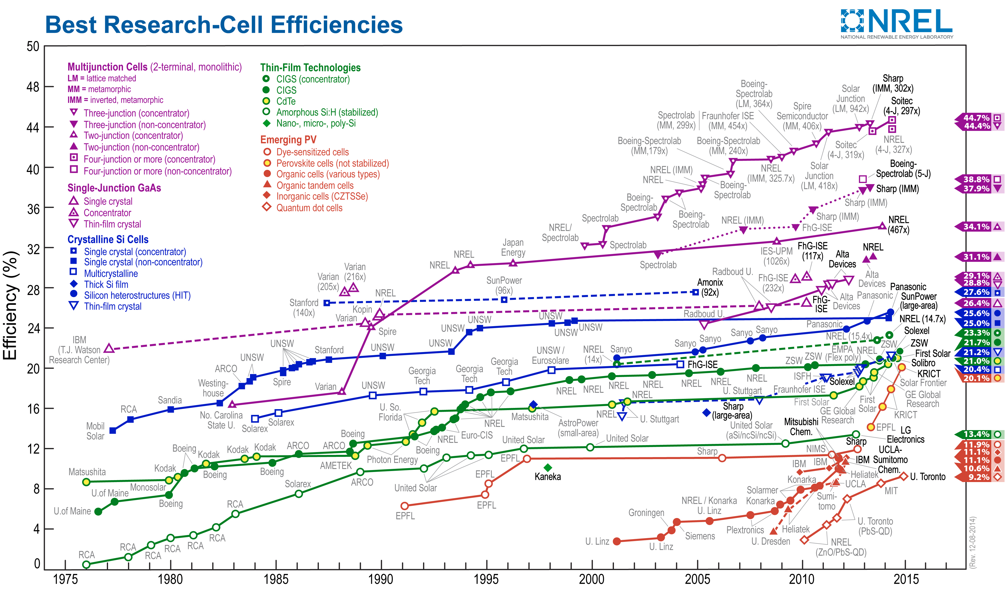
The full (high-resolution version) of the 2018 NREL chart:
This chart's file is HUGE, starting out more than four times the size of a PowerPoint slide
So I will only use this high-resolution version here (and you may have come back to magnify its details)

Slide 17
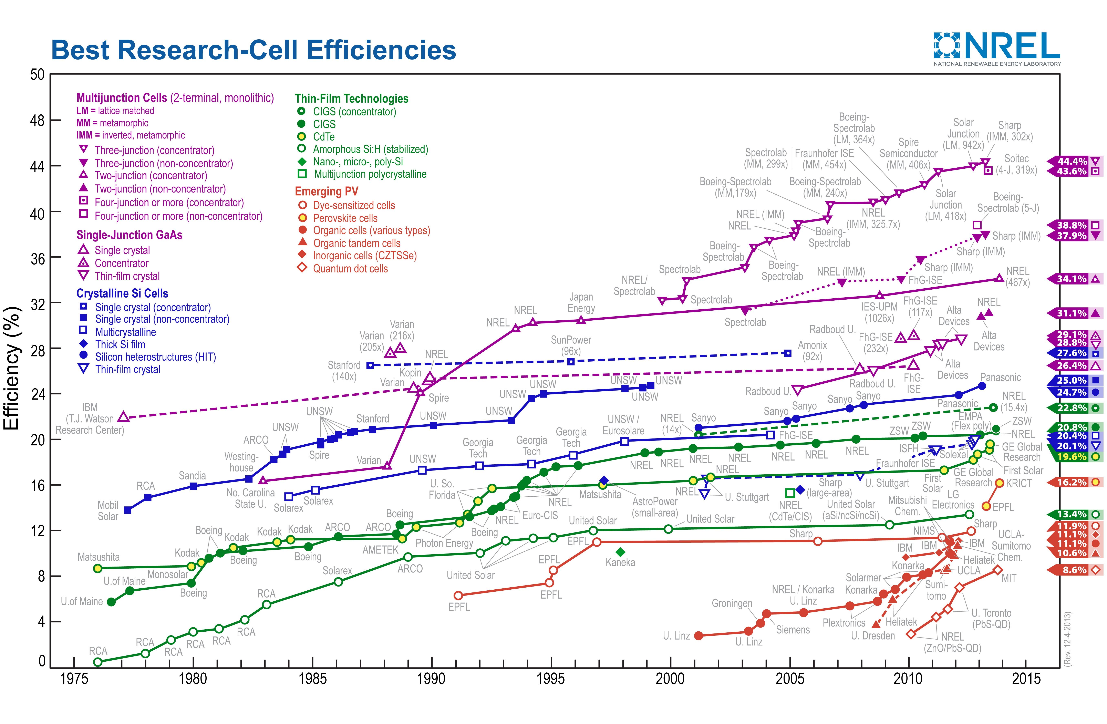
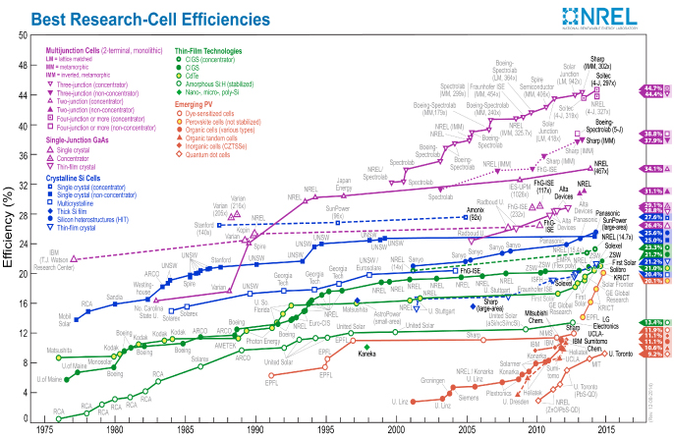
Today's mature & commercialized cells fall in the chart's center
This note set's featured emerging cells are at the top & lower right:
Emerging Multi-junction / Tandem PV
Single crystal GaAs PV
Single crystal Si PV
Polycrystal Si PV
Amorphous Si PV
Emerging Thin-Film PV

Slide 18
Research on "thin-film" PV cells targets cost reduction
As their name suggests, these cells use only very thin sunlight-absorbing layers
  Generally sprayed or painted on cheaper substrates such as sheet metal
Thinner light-absorbing layers reduce cost . . . but they can also reduce cell efficiency
  One reason thin-films fall in the lower-efficiency bottom half of the chart
Established Thin Film PV:
Polycrystal Si
Amorphous Si
Emerging Thin-Film PV

Slide 19
Research on "multi-junction" / "tandem" PV cells targets improved efficiency
Which is achieved by merging together several different PV cells
  Each targeting only that part of the sun's spectrum that their chosen material
    most efficiently absorbs and converts (by minimizing Butt-Kicking)
The challenge: Can such a large increase in complexity ever yield affordable PV?
Emerging Multi-junction / Tandem PV

Slide 20
Thin Film Photovoltaic Solar Cells:
1) https://www.nrel.gov/pv/assets/pdfs/pv-efficiencies-07-17-2018.pdf

Slide 21
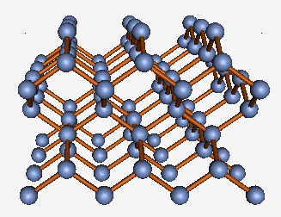
Light-liberated electrons MUST reach the cell's charge-sorting electric field
Sunlight in
Electric Field
Light-liberated electrons
(and bond holes) created
Which may NOT occur if they instead get hung up at those black blobs (traps)
  These are generally faulty crystal bonds, or certain deadly impurities
The dominant "Crystalline Si" PV technology avoids such "traps" through its use of:
              Almost flawless (~ 1 atom in 10¹⁵ out of place)
              hyper-pure (~ 1 impurity per trillion atoms)
              silicon crystals - Which are thus quite expensive!
GaAs has a zincblende crystal structure which is really almost identical, except:
From my own UVA Virtual Lab website, here: http://www.virlab.virginia.edu/VL/Semiconductor_crystals.htm

Slide 22
Flawed or completely disordered silicon is a heck of a lot cheaper!
Other possible silicon structures (in simplified 2D representations):
Multi-crystalline:
Poly/microcrystalline:
Amorphous:
The wealth of flawed, broken or missing crystal bonds creates myriad electron traps
But if a large quantity of hydrogen is added to such structures,
  IT attaches to the traps, rendering most ineffective (i.e., "passivating" them)
Which is exploited in commercial thin-film poly-Si & thin film amorphous-Si PV cells
  Which ARE much cheaper, but also less efficient (not all traps are passivated),
    and shorter-lived (because the hydrogen can gradually escape)

Slide 23
Is hydrogen also the salvation of "Emerging Thin Film" PV cells?
No, most of these instead rely on what I call mushy* semiconductors
The exceptional strength of Si-Si bonds facilitates growth of its extraordinary crystals
  But it also means that, once grown into crystals, Si atoms can't move around
    And that includes not moving to fix any flaws grown into that crystal
Thus, from the outset, Si PV crystals must be extremely pure and perfect!
But in far less stable, low melting point semiconductors, atoms CAN move around
Meaning that (at least to some extent) these materials CAN self-heal
  And much poorer starting crystals (or polycrystals) often work well for PV!
But there is also a down side: Low T semiconductors ARE less stable
So their PV cells often readily degrade (accelerated by moisture & UV sunlight)
  Further, breaking down, they can release their often toxic components
* As a career PV researcher (link), I reserve my right to make up descriptive (if somewhat silly) technical terms

Slide 24
What are those mushy "Emerging Thin Film" alternatives to Silicon?
Emerging Thin-Film PV
We'll need to enlarge this corner of the NREL chart:

Slide 25
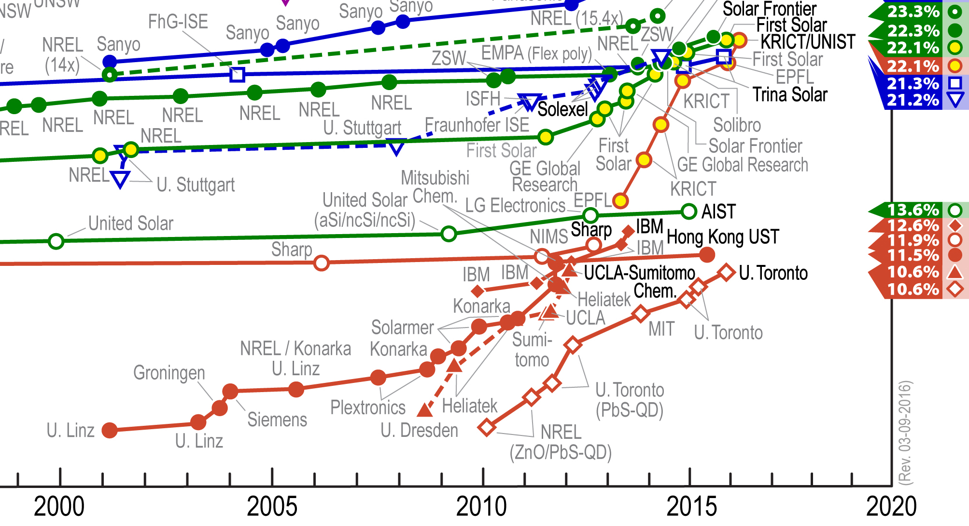
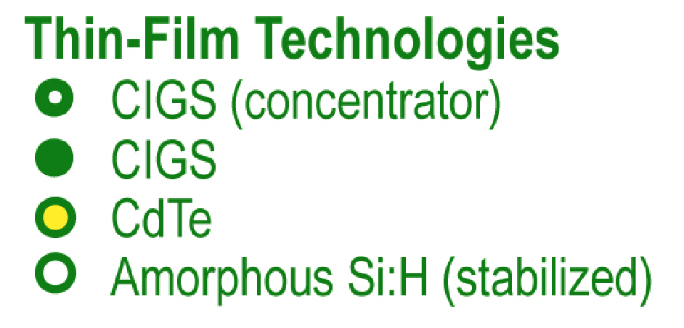
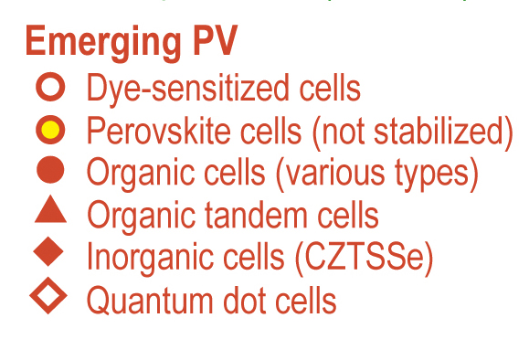
That corner (and its explanatory keys):
Efficiency of light to electric power conversion
(Established & commercialized)

Slide 26
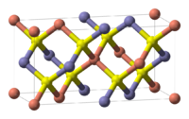
Starting with the older thin film technologies:
Being more mature, they tend toward higher but more slowly improving efficiencies
No longer considered "emerging" is Copper Indium Gallium Selenide = CuIn_{x}Ga_{1-x}Se₂
http://en.wikipedia.org/wiki/Copper_indium_gallium_selenide
In its structure Cu takes one site, either In or Ga takes the next, and Se takes the last:
  Which makes "CIGS" an alloy of two compounds
    (x in formula = the In fraction, remainder 1-x = the Ga fraction)
The two (fixed stoichiometry) compounds:
  CuInSe₂ with an electron liberation energy (bandgap) of 1.0 eV, and
  CuGaSe₂ with an electron liberation energy (bandgap) of 1.7 eV
Thus for CuIn_{x}Ga_{1-x}Se₂, as x changes from 0 to 1, CIGS bandgap goes 1.7 to 1 eV
So you can TUNE a CIGS cell to the maximum Shockley-Quiesser efficiency

Slide 27
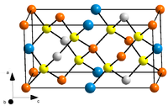
Closely related to CIGS but still "emerging" are thin film CZTS & CZTSe
Standing for copper zinc tin sulfide (Cu₂ZnSnS₄) & copper zinc tin selenide (Cu₂ZnSnSe₄)
  Which can be alloyed together as CZTSSe (more precisely: CZTS4xSe4(x-1) )
CZTS and CZTSSe crystal structure: Versus the CIGS crystal structure of:
With color coding of Cu, Zn, Sn, S or Se Versus Cu, In or Ga, Se
While not identical, these are all very, very similar, as are their solar cell properties
The big difference is that CZTS eliminates toxic Se in favor of more abundant, less toxic, S
  CZTS should be more environmentally friendly
    And its use of more abundant S could make it cheaper
But at this point CIGS cells are still ~ 2X more efficient (22.3% vs. 12.6%)
CZTS figure: http://en.wikipedia.org/wiki/CZTS

Slide 28
Similar to CIGS in maturity are "Dye-sensitized solar cells" (DSSCs):
CIGS:
DSSCs:
Efficiency of light to electric power conversion
(Established & commercialized)

Slide 29
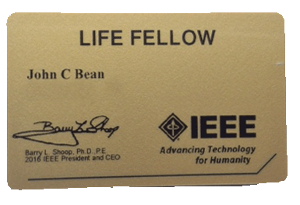
Explanation of DSSC's requires delving into terminology:
Most of the preceding cells come from the physics & electrical engineering world
Known as the "Device Physics Community"
Of which, yes, I am a card-carrying member:
DSSC's were instead developed by chemists (or even the occasional biologist)
The science is essentially similar
But the terminology is fiercely different, as is the researcher's approach:
- Physicists focus on atomic scale mechanisms (getting vague at larger scales)
- Chemists focus on macroscopic properties (getting vague at the atomic scale)
So what follows is my attempt at both bridge-building AND translation
An Introduction to Sustainable Energy Systems: WeCanFigureThisOut.org/ENERGY/Energy_home.htm

Slide 30
Chemistry speak vs. Physics speak:
Papers on DSSC's (and the organic cells to follow) talk about three things:
1) Dyes or photo-sensitizers in which light produces unbonded electrons & holes
Using my 1st solar lecture key of = atomic cores, = electrons:
  Absorption of light liberates a bond electron
Thus: Chemist's "Dye / photo-sensitizer" = Physicist's "semiconductor"
2) Hole transport materials (or layers) in which ONLY holes can move:
An Introduction to Sustainable Energy Systems: WeCanFigureThisOut.org/ENERGY/Energy_home.htm

Slide 31
Only holes move? But weren't electrons really moving?
Yes, but the subtle distinction is as follows:
A single hole move = valence electron slithering from one bond to an adjacent one:
But it really doesn't have to jump as it's actually a quantum mechanical cloud
Which can just ooze around the atom's core from one bond to another:
That oozing requires very little additional energy
- In Physics speak: This electron remains in the "valence band"
- In Chem speak: It's in the "HOMO" = Highest (normally) Occupied Molecular Orbital
An Introduction to Sustainable Energy Systems: WeCanFigureThisOut.org/ENERGY/Energy_home.htm

Slide 32
As opposed to the movement of a truly unbonded electron:
This electron cannot just ooze from one side of an atomic core to the other:
Because it's outside the atomic core (which is already fully packed w/ electrons)
So it's at a much higher energy - Physicist: it's in the "conduction band"
Chemist: It's in the "LUMO" = Lowest (normally) Unoccupied Molecular Orbital
Which, also in Chem-speak, makes the material above an:
3) Electron Transport Material (or layer)
In their preferred liquid environment, Chemists can simplify things further:
Electron Transport Material (wet) => Solution with negative ions (anions)
Hole Transport Material (wet) => Solution with positive ions (cations)

Slide 33
All three things occur in the physicist's classic semiconductor solar cell
Why wouldn't all three things happen in ANY single material?
1) If bonds are too strong (the "bandgap" is too large), light won't be absorbed,
=> Electrons will not be liberated from bonds
2) If bonds are too strong, any loose electrons won't stay liberated,
=> Killing off (unbonded) electron transport
3) If material's bonds are oriented or separated differently, result might be that
Quantum Mechanical "oozing" of electrons between bonds is far less likely
=> Killing off valence band hole transport
Chemists like to divide the three functions between different materials
An Introduction to Sustainable Energy Systems: WeCanFigureThisOut.org/ENERGY/Energy_home.htm

Slide 34
Chemist's DSSC (or organic) solar cell:
Which divides the three phenomena / functions between three different layers
The actual geometry is more complex:
With light coming in through either the Electron or Hole transport layer
And instead of flat planes, a much more convoluted 3D geometry is used
This structure SEEMS to do required job of sorting electrons from holes
Sending them in opposite directions to form an "electrical current"
Sunlight in
Thick Electron Transport layer
Thin Dye layer
Thick Hole Transport
layer
An Introduction to Sustainable Energy Systems: WeCanFigureThisOut.org/ENERGY/Energy_home.htm

Slide 35
But hold it: There is no "push" => No power!
Electrical Power = Flow x Pressure = Current (I) x Voltage (V)
Above scheme shows no way of producing the pressure/voltage:
It's not yet a pump!
It's just bucket leaking electrons left & holes right:
To be a bit more technical:
While it's "short circuit current" (unopposed flow) might be finite
It's "open circuit voltage" (electrical force) would be ~ zero
Thus, while papers on DSSC's and Organic Solar Cells seldom mention it,
There has got to be something MORE going on!
Sunlight in
An Introduction to Sustainable Energy Systems: WeCanFigureThisOut.org/ENERGY/Energy_home.htm

Slide 36
There must be at least one pushing Electric Field:
Sunlight in
Thick Electron Transport layer
Thin Dye layer
Thick Hole
Transport layer
Interfacial Electric Fields
Material of the electron transport layer" CANNOT ONLY transport electrons
Line up of its energy levels vs. those of the the Dye layer
MUST promote electron transfer across that interface (=> E field)
AND/OR material of the "hole transport layer" CANNOT ONLY transport holes
Line up of its energy levels vs. those of the Dye layer
MUST promote electron transfer across that interface (=> E field)
An Introduction to Sustainable Energy Systems: WeCanFigureThisOut.org/ENERGY/Energy_home.htm

Slide 37
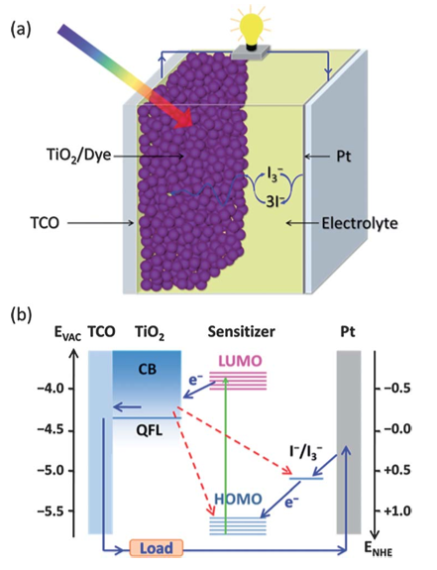
Finally moving on to actual DSSC configurations:
Geometry: Corresponding energy levels:
Dye/Sensitizer coats surfaces of TiO₂ particles
Electrons photo-generated in the dye move into the TiO₂ electron transport layer
Holes in dye layer are then filled by electrons from I⁻ ions arriving in the electrolyte
By absorbing holes, this serves the role of a hole transport layer
(with I⁻ ions then regenerated at far right Pt electrode)
Energy levels are indeed carefully chosen to promote interfacial electron transfer
Thereby supplying (even if never mentioned) the pushing electric fields
Highly Efficient Dye-Sensitized Solar Cells: Progress and Future Challenges, Y. Zhang et al.,
Energy and Environmental Science 6, pp. 1443-1464 (2013)

Slide 38
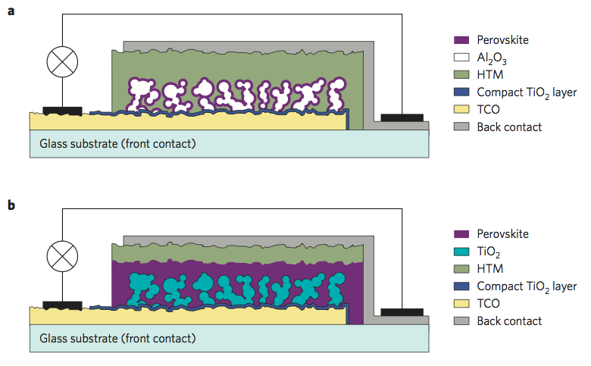
Or getting rid of liquids and moving to all solid state:
  THIN Perovskite Dye (light absorber) on Al₂O₃ particles (electron transporter)
(HTM = hole transport material, TCO = top contact transparent oxide)
ALTERNATE more strongly sunlight-absorbing structure:
  THICK Perovskite Dye (light absorber) on TiO₂ particles (electron transporter)
The Light and Shade of Perovskite Solar Cells, Michael Grätzel, Nature Materials 13, pp. 838-842 (November 2014)

Slide 39
Where I just snuck in Perovskite thin film solar cells
Which have been rocketing up the NREL chart:
:Perovskites
Which is attributed to BOTH electrons & holes moving REALLY well in perovskites:
=> LONG electron/hole diffusion lengths due to very few and/or ineffective traps
Perovskites = "Mushy" less stable but remarkably self-healing semiconductors

Slide 40
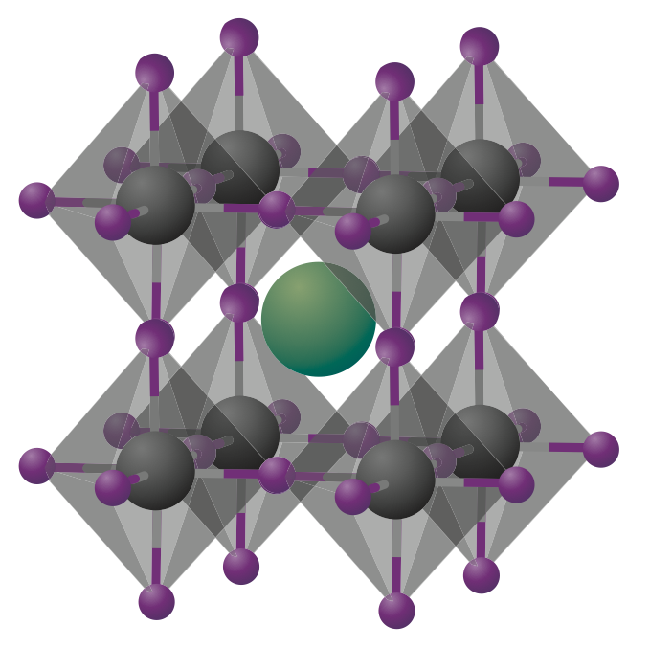
The Perovskite family structure and formula:
Take as the basic repeating crystal building block ("unit cell"):
The CUBE with fat gray B's in its corners
A = Organic or inorganic cations (+) = green: 1 per cell
B = Metal cations (+) = gray: 1 per cell
8 corner atoms x (1/8 of each inside our cube) = 1 inside each unit cell
X = Anion (-), frequently halide = purple: 3 per cell
Don't count any atoms outside of the gray atom bounded cube
Every gray cube edge (12 of them) has a purple X atom at its center
But only ¼ of each of those purple X atoms is inside our cube (i.e. )
Thus X count = 12 edge atoms x (1/4 of each inside or cube) = 1
So general formula of repeating perovskite unit cell is: ABX₃
Figure: The Light and Shade of Perovskite Solar Cells, Michael Grätzel, Nature Materials 13, pp. 838-842 (November 2014)

Slide 41
For Perovskites used in solar cells:
ABX₃ is made up of:
A organic cation = Methylammonium (CH₃NH₃⁺)
B metal cation = Lead (Pb⁺)
X anion = Iodine (I⁻) and/or Bromine (Br⁻) and/or Chlorine (Cl⁻)
Synthesis DOES NOT REQUIRE energy-intensive high temperature crystal growth!
Perovskites can instead be evaporated onto surfaces OR
Deposited from liquid using PbX₂ and CH₃NH₃X dissolved in solvents
Offering: 1) Simple (almost trivial!) fabrication technology
2) Excellent performance due to long free electron / hole diffusion lengths
3) Combined or separated absorption + hole & electron transport by layer

Slide 42
Which makes Perovskites sound like the PV silver bullet
But the "fly in the ointment" is:
- The most common Perovskites are built around toxic lead
- And, because Perovskites go together so easily, they also fall back apart!
Specifically: In contact with water, lead iodide Perovskite releases PbI
Which is a known carcinogen
That is banned in many countries ¹
This has fueled intensive research on alternate Perovskites
Including those which replace Pb with Sn
But these have not yet produced comparable solar cell performance
Nor do they achieve comparable cell stability/lifetimes
So Perovskite PV is a "Stay tuned for further developments" sort of story
1The Light and Shade of Perovskite Solar Cells, Michael Grätzel, Nature Materials 13, pp. 838-842 (November 2014)

Slide 43
Completing the emerging group are Organic PV and Quantum Dot Cells:
Efficiency of light to electric power conversion
Quantum Dot Cells
Organic Cells

Slide 44
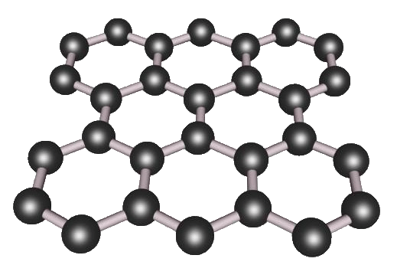
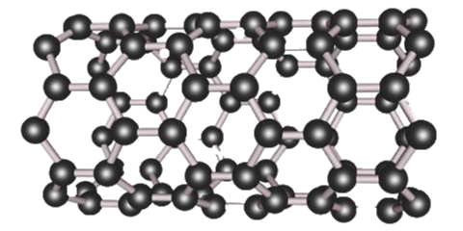
"Organic" PV cells share the chemistry of earth-borne life:
Using complex molecules & polymers consisting of mostly C, H, O & N
Organic cells work, they can be very cheap to build, they can literally be flexible
But you know what happens if organics are left in sunlight (e.g., rubbers & plastics)
They fade, crack, and eventually crumble - Why? Answer:
UV not only liberates electrons from organic bonds, it often breaks those bonds
  => A major reason Organic PV cells end up at the very bottom of NREL's chart
But one group of TOUGH ORGANICS has been getting a lot of press attention:
Graphene: Carbon Nanotubes - CNTs (Rolls of Graphene)
But these "tough organics" appear NOWHERE on NREL's Best PV Cell chart!
So why all of the hype? What is really going on?

Slide 45
To explain, I need to discuss the complete structure of a solar cell:
Which would have to include at least these parts:
But likely with these final proportions / arrangement:
Sun
Metallic Wire
Metallic Contact Layer
Electric Field
Light-liberated electrons & holes
Transparent
Metallic Contact Layer
Metallic Wire
An Introduction to Sustainable Energy Systems: WeCanFigureThisOut.org/ENERGY/Energy_home.htm

Slide 46
In that full structure, where might Graphene/Nanotubes be used ?
Well, what are they really good at / good for?
1) They are really, really strong – but that's largely irrelevant to solar cells
2) Electrons can move through them really, really easily and quickly
Which is to say that they are superb conductors
So they COULD be used in: Top wire, bottom metallic contact, bottom wire
And this IS (frequently) suggested in the press and by researchers
But in those places standard metals already work pretty well
And substitution of graphene/CNTs => Minimal impact on efficiency
The top contact offers a somewhat bigger opportunity for improvement:
IT must be both a good conductor and largely transparent
THAT is a rare and scientifically challenging combination:

Slide 47
A "good conductor" must pass a lot of electrical current easily
Electrical current = (#number of free electrons) x (average electron speed)
Graphene/CNT electrons can travel at exceptionally high speeds
So graphene is a good conductor despite having fewer electrons than metals
A "transparent material" has to allow light (here sunlight) to pass through
Light = Oscillating electric (and magnetic) fields
When light's electric field strikes conductor, field shifts electrons:
Electron shift => polarization => counter electric field
If there are enough electrons, counter electric field cancels light field
And such free-electron rich materials (metals) end up acting as mirrors
But graphene has fewer electrons => Poor mirror (i.e., it's more transparent!)

Slide 48
So graphene/CNT's could help out in transparent front conductor
This could trim the cost a little
Because alternatives such as Indium Tin Oxide (ITO) are costly
And/or it might slightly goose up efficiencies (say, a few percent)
Which would certainly be nice, but which would not yet be a huge deal
To be a huge deal, graphene/CNT's would have get out of the boonies of the cell!
AND instead enable big improvement in the function of the:
Semiconductor/dye, electron or hole transport layers
But graphene is NOT a natural semiconductor, it's effectively a metal meaning that:
Electron liberation energy ~ 0 => No pushing force (Voltage) from layer(s)
However, SOME forms of CNT are semiconductors so there is a possibility here

Slide 49
But the ONLY possibility justifying the current level of excitement is:
If, in the heart of the cell, CNT's (or some modified form of graphene)
could use excess photon energy to liberate additional electrons
Instead, now, one photon gives all of its energy to only one electron
And if that photon's energy is MORE than enough to liberate that electron
excess energy goes into electron's kinetic energy and it just ricochets around,
causing atoms to vibrate, sucking up that energy as waste heat
= Fundamental reason ALL solar cell efficiencies are << 100%
But in graphene, it's believed that energetic photon might liberate 2 electrons
HOWEVER, reports have been rare and that result has been very hard to replicate
Leading to my personal conclusion that:
Current bubbly press about graphene/CNT solar PV is premature and/or naive

Slide 50
Bringing us to Quantum Dots and the weird world of Quantum Mechanics
Which invokes the famous (or infamous) "Wave / Particle Duality"
Specifically, in about 1900, it was recognized that electrons (thought to be particles)
  exhibited behavior then only recognized in waves (of sound / water / light . . . )
Compelling the invention of a whole new set of rules, called quantum mechanics
  For which the saving grace was that all waves exhibit very similar behavior
    So electron waves should act like sound / water / light . . . waves
UNCONSTRAINED sound / water / light . . . waves can have all sorts of energies
  The greater their energy, the greater their frequency (the lower their wavelength)
But TRAPPED in boxes (e.g., "dots"), waves bounce back & forth and back & forth . . .
  With the generated left & right moving waves tending to cancel one another out

Slide 51
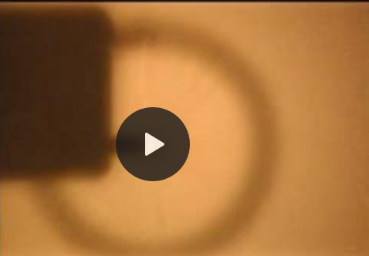
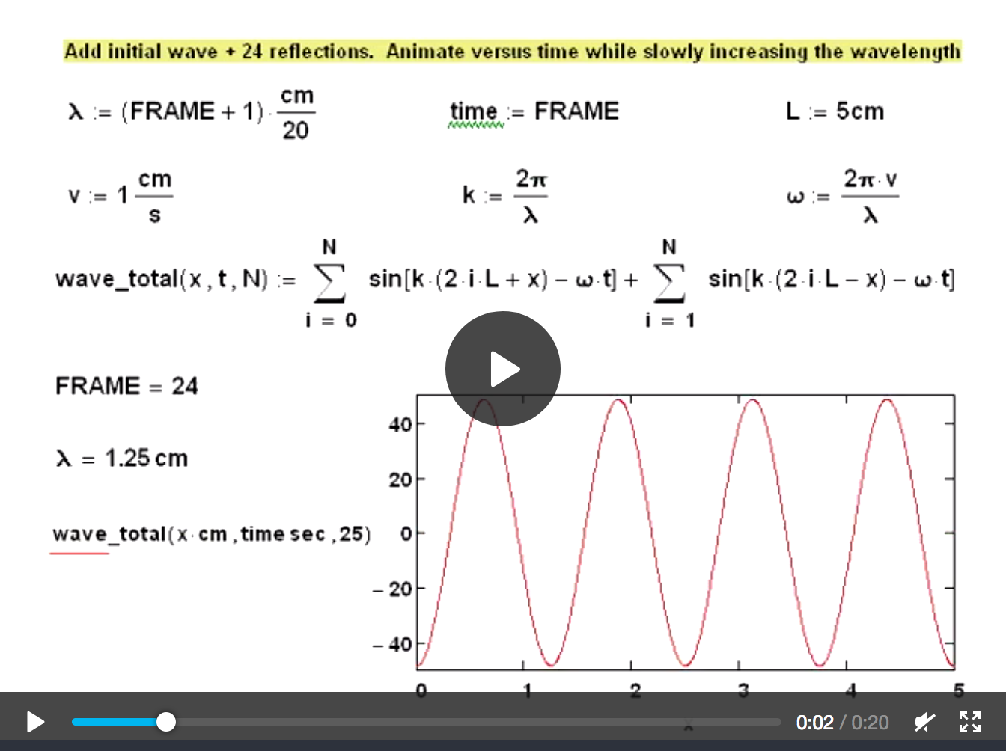
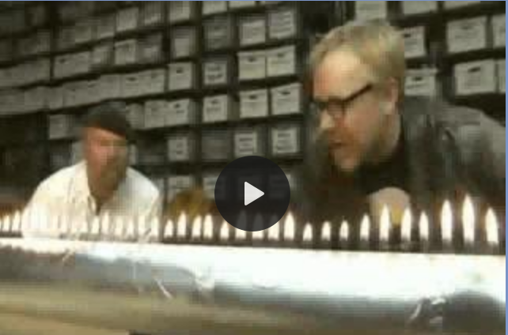
But in such boxes, cancellation does NOT occur for certain wavelengths
A ricocheting wave CAN survive IF its wavelength "fits" in the box, for instance when:
  Wavelength (𝝺) = Box-width, Box-width/2, Box-width/3, Box-width/4 . . .
In my Nanoscience class lab, we observed this for waves trapped in springs and water
  I also created a mathematical simulation of waves bouncing within a box
    My Nanoscience class notes on: "Waves (electron)" (pptx / pdf / key)
    That note set's Resource Webpage (Link) with embedded movies of:
      - The lab's trapped water waves
      - My animated mathematical simulation of trapped waves
      - YouTube's Mythbuster & other demonstrations of trapped waves

Slide 52
Summarizing Quantum Dot (Q-dot) factoids to this point:
Electrons act like waves
  Unconstrained waves can have all sorts of frequencies & wavelengths
    Implying different energies, because higher frequency => higher energy
But when trapped, and forced to ricochet back and forth within a BOX:
  Most waves end up canceling themselves out
AN EXCEPTION = Trapped waves whose wavelength's = (width of box) / (an integer)
  Surviving waves thus have QUANTIZED ENERGIES (these waves = "standing waves")
    Which is HOW Quantum mechanics got its name!
      As it struggled to explain known energy levels of electrons bound within atoms
CONSEQUENCE: As size of box changes, so should surviving electrons' wavelengths
  Different size "atomic boxes" => Different allowed electron wave energies
  THUS: Different size quantum-dots have different electron energy levels =
The "QUANTUM SIZE EFFECT"

Slide 53
Quantum-dots can be made of ALL SORTS of different materials
But the exact choice of their material becomes largely irrelevant!
Because sunlight's absorbance is no longer due to electron liberation from bonds
It's instead due to light kicking electrons from one quantum-energy-level to another
  With energy levels (and hence their differences) determined by the Q-dot SIZE
Thus, to make a solar cell with peak Shockley-Quiesser efficiency:
You no longer need to find a material with electron liberation energy of ~ 1.3 eV
Instead, just embed Q-dots with two trapped wave energies differing by ~ 1.3 eV
Which is no longer determined by material, but (mostly) by the Q-dot's SIZE
Which YOU CAN CONTROL (vs. Mother Nature's control of material's bandgap)

Slide 54
What would such an embedded Q-dot solar cell look like?
Building from the example of conventional semiconductor photovoltaic cells:
Swap of charge across junction => ELECTRIC FIELD => Sorting of electrons/holes
OUT Electrical Current Pump IN
An analogous one Quantum Dot photovoltaic cell:
For instance, when semiconductor or polymer quantum dot meets metal:
OUT IN
Nano sized Q-dots => Nano power so we need LOTS of them working together:

Slide 55
A better Quantum dot solar cell:
With lots of same-size Quantum dots:
Transparent front conductor
Quantum dots
Charge separating Electric fields
Back Conductor
What's going on here? You choose special quantum dot & back conductor materials
So that interface between them swaps charge, setting up electric field
Which propels ONLY photo-generated holes into back conductor
Leaving photo-generated electrons to be collected by front conductor
Result is MANY nano electron pumps working together ("in parallel"):
But this STILL uses only 1 thin light-absorbing QD layer => Very little current

Slide 56
An improved FOLDED quantum dot layer solar cell:
THIS would be much better = MORE DOTS! With materials chosen so that:
- Blue metal collects only charge from green
- Green sucks positive charge from dots
- Yellow sucks negative charge from dots
- Gray metal collects only current from yellow
  - Green and yellow self-segregate into such a pillared structure in which Q-dots go to interface
Sounds incredibly complex, doesn't it? But such designs ARE being researched
E.G., Green and Yellow = Immiscible conducting polymers (e.g. "Block co-polymers")
But single size Q-dots cells STILL convert only
~ 10.6% of sunlight energy to electrical energy
Putting them near bottom in the NREL chart:
Could Q-dots be used more effectively?
Q-dot Cells

Slide 57
Emerging "Multi-junction" / "Tandem" Photovoltaic Solar Cells
An Introduction to Sustainable Energy Systems: WeCanFigureThisOut.org/ENERGY/Energy_home.htm

Slide 58
The Shockley-Quieser Limit = Choice of one "best" solar cell material:
Cell with small "bandgap"
Cell with medium "bandgap"
Cell with large "bandgap"
VIS
VIS
VIS
Butt
Kicking
Energy absorbed by solar cell
Energy absorbed by solar cell
Energy absorbed by solar cell
Butt Kicking
Butt Kicking
Electron
Liberation
Electron Liberation
Electron Liberation
0 eV
Light's Energy
5 eV
0 eV
Light's Energy
5 eV
0 eV
Light's Energy
5 eV
But in even BEST ~1.3 eV material, a good chunk of sunlight's energy (two-thirds!)
  is wasted on non-electricity-producing electron "Butt-Kicking"
    = Excessive kinetic energy of liberated electrons (ultimately lost as heat)
What if cells of EACH different material were stacked atop one another?

Slide 59
Multi-color sunlight in
Top / first PV cell: Material with large bandgap:
  Absorbs UV light with only weak butt-kicking
  Absorbs purple-ish light with ~ zero butt-kicking
  But lets almost all lower energy light pass right through
Middle / second PV cell: Material with medium bandgap:
  Absorbs green-ish light with only weak butt-kicking
  Absorbs orange-ish light with ~ zero butt-kicking
  But lets almost all lower energy light pass right through
Bottom / third PV cell: Material with small bandgap:
  Absorbs red-ish light with only weak butt-kicking
  Absorbs near-infrared light with ~ zero butt-kicking
  Allowing only-deep infrared to pass through unmolested
This is called a "Multi-junction" or "Tandem" PV solar cell

Slide 60
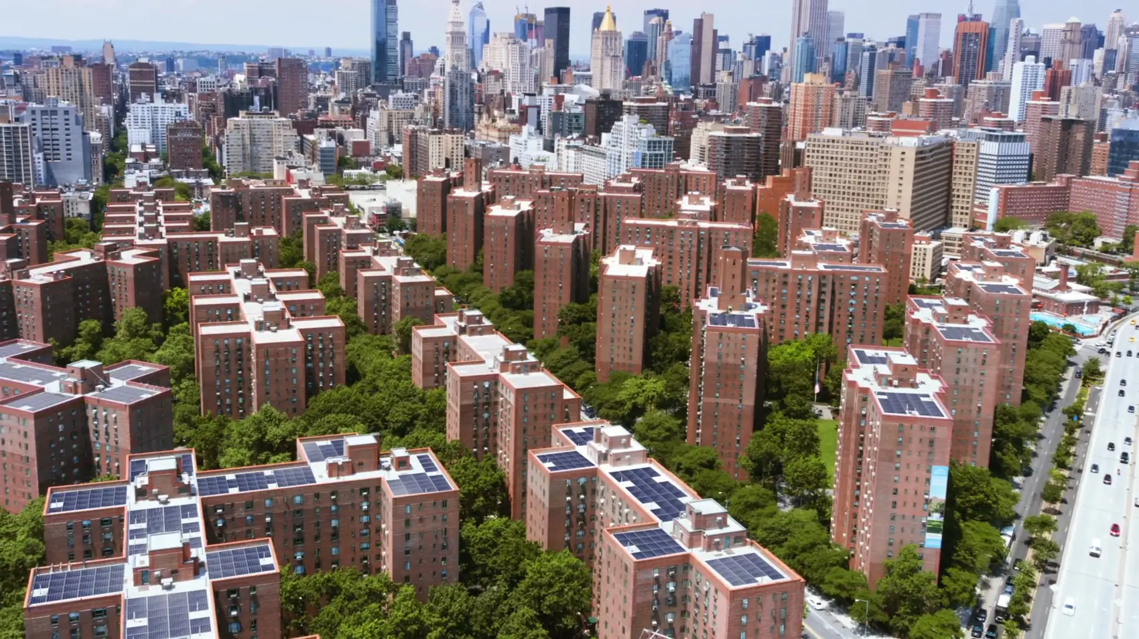

By hugely reducing electron "Butt-kicking" waste, efficiency might soar!
Indeed, overall light to electrical power conversion might approach 100%,
  shattering single-cell PV's Shockley-Quiesser limit of ~ 35%
But use of three cells might also triple overall cost of Multi-junction / Tandem PV
  Or more than triple it, given challenges of electrically & opticially merging cells
PV cell cost per electrical power out might then actually INCREASE!
Relegating Tandem / Multi-junction PV to sites requiring high power per array SIZE
Such as in prime urban environments:
Or when minimizing satellite weight/size:
Where Tandem PV might supercharge this NYC complex:
https://www.stuytown.com/sustainability/solar
Where NASA is promoting Tandem PV research:
https://spinoff.nasa.gov/Spinoff2016/ee_5.html

Slide 61
To cut cost, you must create all necessary layers in a single manufacturing step
For instance, by depositing a full set of CIGS or CZTSSe thin-film layers:
CIGS:
Alloys of CuInSe and CuGaSe
Full Multi-junction / Tandem structure:
High-energy-light absorbing CuGaSe
Atop:
Mid-energy-light absorbing CuInxGa1-xSe
Atop:
Low-energy-light-absorbing CuInSe
CZTSSe:
Alloys of CuZnSnS and CuZnSnSe
Full Multi-junction / Tandem structure:
High-energy-light absorbing CuZnSnS
Atop:
Mid-energy-light absorbing CuZnSnS4xSe4(1-x)
Atop:
Low-energy-light-absorbing CuZnSnSe

Slide 62
OR you could stack layers containing differently-sized Q-dots:
Smaller Q-dots => Shorter wavelength trapped electron waves => Higher electron energies
First capture Blue Light with small quantum dots
Then capture Red Light with deeper large quantum dots
I₁, V₁ I₂, V₂
Done right (probably with more layer/sizes), you might efficiently capture light of ALL colors
But this would require incredible control of Q-dot arrangement and electrical current paths
Making the creation of quantum dots the almost trivial part of task
REAL CHALLENGE here is the required complex 3D SELF-ASSEMBLY

Slide 63
It would be easier if quantum dots could be randomly distributed in layers:
More like this:
You'd still need electric fields to separate light-liberated electrons from holes
But HERE you would NOT want fields between the dots and their surrounding layer:
For instance, field below would drive positive holes out of dot, trapping electrons
Until dot got so negative that it started pulling holes back
Then NOTHING (electrons nor holes) would escape to deliver power!
+
+
+
-
+
-
-
-
-
-
-
+
-
+
+
+

Slide 64
You'd instead want electric fields at layer (rather than dot) boundaries
Which MIGHT be accomplished by:
1) Choosing dot and surrounding layer material to have similar energy levels
So they don't naturally swap charge, thereby building interfacial electric fields
2) But choosing layer materials with differing energy levels
So that they do transfer charge across their interfaces
Thereby adding properly directed charge-pumping electric fields
Producing this Quantum dot multi-junction / tandem solar cell:
I₁, V₁ I₂, V₂
3D self-assembly => A LOT easier
Layer material selection => More difficult

Slide 65
How well are Multi-junction / Tandem PV Cells actually doing?
Emerging Multi-junction / Tandem PV
Enlarging that part of the NREL chart (and its relevant key):

Slide 66
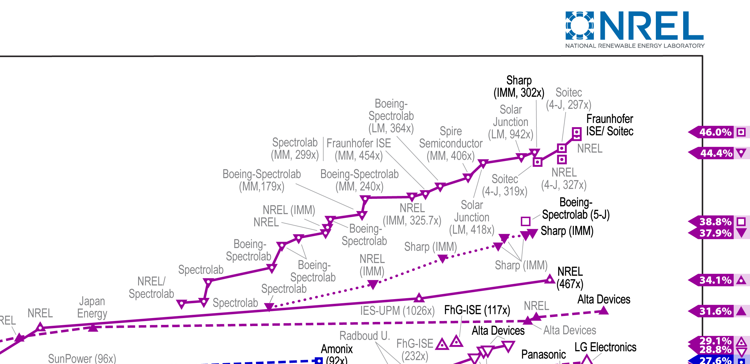
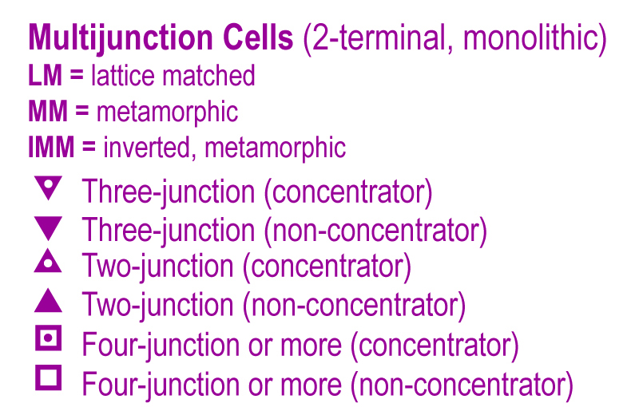
NREL data on Multi-junction / Tandem PV cells (~ 1992 - 2016):
Reading off values called out on the chart's right margin:
  Multi-junction / Tandem PV's are approaching 50% efficiency
    But NOT the near 100% efficiencies one might expect
      if "butt-kicking" wastage of light energy were TOTALLY eliminated!

Slide 67
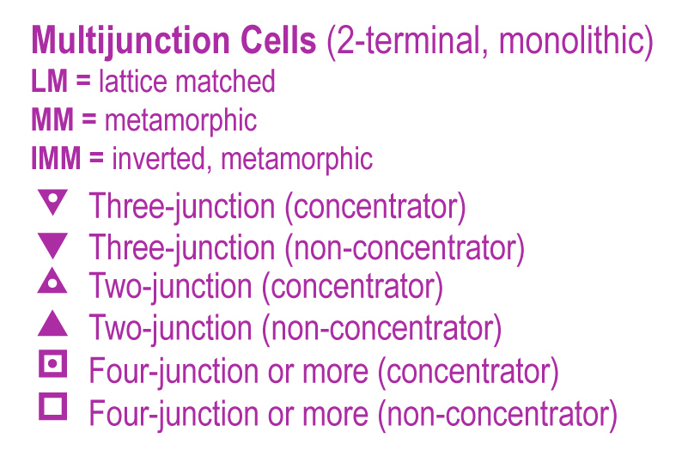
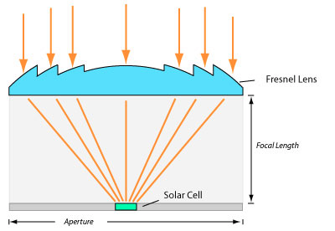
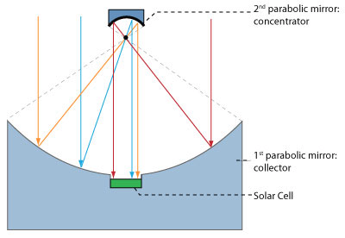
    But what's NREL referring to here?
    Or here (for CIGS thin films)?
What are Concentrator Multi-junction PV cells?
What are Concentrator Thin-Film PV cells?
It refers to concentrating sunlight on SMALL cells via LARGE lenses or mirrors:
http://www.greenrhinoenergy.com/solar/technologies/pv_concentration.php

Slide 68
Why would concentrating sunlight be desirable?
Reason #1) Photovoltaic cells get more efficient as light gets more intense
Revising earlier figure to explicitly depict "traps" created by impurities/flaws:
Even the most crystalline / highest purity PV materials have some "traps" ( )
These reduce the "diffusion length" of wandering holes and electrons
Reducing number reaching to, and then sorted/pumped by, the electric field
But there are a limited number of "traps" interfering with wandering electrons/holes
So overwhelm traps by sending in more intense light => More electrons + holes
  These saturate (fill up) the traps allowing other electrons/holes to pass by!
Sunlight in
Electric Field
Light-liberated electrons
(and bond holes) created

Slide 69
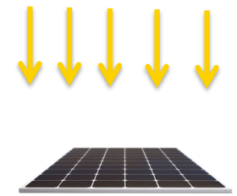
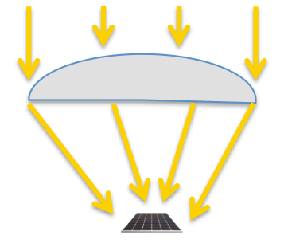
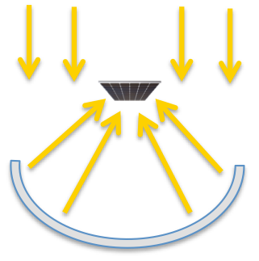
Reason #2 is easier to understand:
If the cost per square meter of PV cell >> Cost per square meter of lens or mirror
(which is VERY likely for complex Multi-junction / Tandem PV cells)
It's cheaper to buy large lenses / mirrors and combine them with small PV cells
You still use all of the light captured by the large lens or mirror
AND
You still get benefit of Reason #1 improvement in small cell's efficiency
COMPARABLE POWER: Large/expensive array vs. tiny PV cells + cheap lens / mirror
VS.
OR

Slide 70
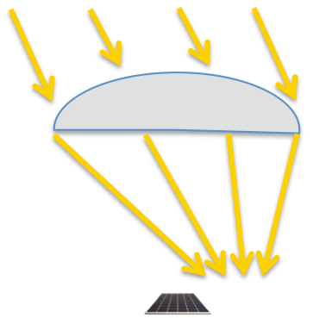
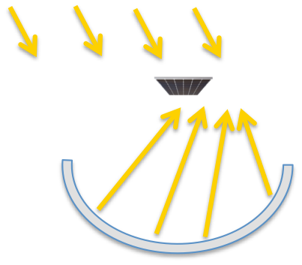
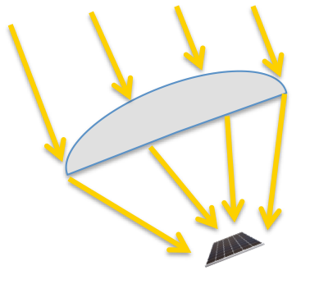
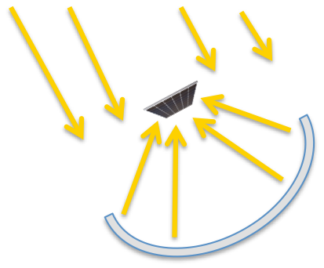
The big problem with concentrators? The sun won't sit still!
And when it moves off lens / mirror axis, light no longer concentrates on the PV cell
RESULT: The whole ASSEMBLY of PV cell PLUS lens / mirror must track the sun:
  Tilting East to West (minute by minute) EVERY DAY
    AND tilting more SOUTHWARD during (northern hemisphere) winter
Likely demolishing the cost advantage of Concentration + Tandem PV cells!
(at least until a tilt-proof concentrator is invented)

Slide 71
Luminescent Solar Concentrators
An Introduction to Sustainable Energy Systems: WeCanFigureThisOut.org/ENERGY/Energy_home.htm

Slide 72
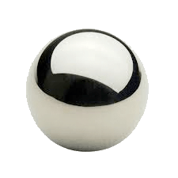
How to build a concentrator that is at least tilt-resistant:
Imagine a shiny ball-bearing inside a sheet of transparent plastic (seen here edge on)
Think about how different rays of light will bounce off that ball-bearing (click now):
A slightly off-center ray will bounce back upward
Most of it will escape the top (bending outward according to Snell's Law")
But a little will bounce, heading toward the back of the sheet
      (And so on and so on. . . getting weaker with each bounce) click
A more off-center ray will also bounce back upward (but more to the side)
Some of it will escape the top (bending outward according to Snell's Law")
Some of it will bounce, heading toward the back of the sheet
      (And so on and so on. . . getting weaker with each bounce) click
A very off-center ray will bounce back upward (even more to the side)
But NONE of it will escape the front due to total internal reflection
ALL of it will ricochet back & forth until it reaches the sheet's end!
An Introduction to Sustainable Energy Systems: WeCanFigureThisOut.org/ENERGY/Energy_home.htm

Slide 73
Remember lurking on the bottom of a swimming pool?
From it depths you could see the sky far above
  But looking to the side, the sky's image mixed with a reflection of the pool's bottom
    And far to the side, you could see ONLY a reflection of the pool's bottom
THAT was total internal reflection:
Where light moving at a glancing angle to an interface
gets trapped inside the material in which light moves more slowly
(i.e., inside the material that has the higher "index of refraction")
The critical angle for total internal reflection = Sin⁻¹ (nsurrounding / nsheet)
  Where nsheet = the transparent sheet or fiber's index of refraction
  And nsurrounding = the surrounding material's index of refraction
If the sheet / fiber is made of typical transparent glass or plastic, then nmaterial is ~ 1.5
  And if the surrounding material is air, nsurrounding = 1
    In which case, the critical angle for trapping light is about 42 degrees

Slide 74
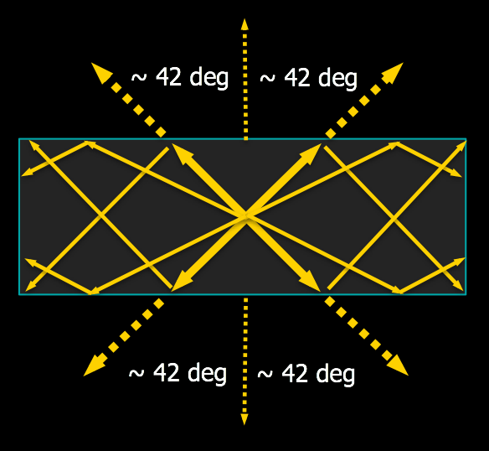

Much/most of light emitted within such a layer stays within that layer
Only light directed toward front & back (into ~ 84 degree wide cones) can escape
Light is similarly trapped within glass fibers
enabling the fiberoptic telecommunication
underlying CELL PHONES & THE INTERNET
For more info, including a derivation of the critical angle formula, see Wikipedia's relevant webpage:
https://en.wikipedia.org/wiki/Total_internal_reflection
Image at is from a tutorial on Fiber Optic Telecommunications:
https://www.elprocus.com/basic-elements-of-fiber-optic-communication-system-and-its-working/

Slide 75
Returning to our embedded-ball-bearing would-be concentrator:
Lots of light from above travels to sheet's ends - where it's concentrated
Lots of light from the side ALSO travels to sheet's ends - where it's also concentrated
Suggesting that we've might have found our cheap tilt-resistant concentrator
To which we could just connect tiny PV cells at its ends!

Slide 76
But a solar concentrator should capture light from its entire front:
Suggesting a concentrator more like this:
But then, what one ball-bearing helped trap, another might just go and untrap!
For such a scheme to work over the entire area, we'd really need:
  Magical ball-bearings that ONLY REFLECT NEWLY ARRIVED light,
  ignoring light that's already bounced off another magical bearing

Slide 77

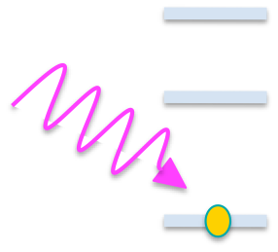

Bringing us to the "luminescent" in Luminescent Solar Concentrators
Forget the ball-bearings, and substitute Quantum-dots or organic "dye" molecules
Quantum-dots & Dyes are extremely small and subject to The Quantum-Size Effect
  Their trapped electron waves thus have only a few short wavelengths
    Which correspond to only a few widely spaced energy levels
Here showing the top electron-filled level, plus two higher unfilled levels:
Shine high-energy sunlight (violet or bluish) on that Dot / Dye:
The light's energy is absorbed by the electron
which is kicked into a higher energy level
An Introduction to Sustainable Energy Systems: WeCanFigureThisOut.org/ENERGY/Energy_home.htm

Slide 78
The electron can then trickle back down, loosing energy by emitting light
In some dots / dyes, the falling electron may "rest" at intermediate energy levels
  Loosing energy stepwise, via the emission of multiple photons of lower energy
    (this would produce "down-conversion" of the light):
Luminescence = This process of induced light emission:
  If the incoming energy was electronic, it's called electroluminescence
  If the incoming energy was light, it's called photoluminescence
    Alternate term for light in => lower energy light out = fluorescence
An Introduction to Sustainable Energy Systems: WeCanFigureThisOut.org/ENERGY/Energy_home.htm

Slide 79
One would expect photoluminesence to be reversible:
Allowing multiple red photons to (ultimately) generate a violet photon:
But in many dots & dyes the reverse is possible but highly improbable
  As governed by weirdness such as "Selection Rules" & "Fermi's Golden Rule"
Bringing to mind the classic quote from the father of Quantum Mechanics, Neils Bohr:
"If quantum mechanics hasn't profoundly shocked you,
you haven't understood it yet"
THOSE are the dots & dyes chosen for luminescent solar concentrators:
YES:
+ NO:

Slide 80

Non-reversible down-conversion => Luminescent Solar Concentrators:
Which replace reflecting ball-bearings with those specially chosen Quantum-dots or Dyes:
- Full spectrum sunlight shines on LSC from above
- Only high-energy violet / blue light is absorbed by Quantum-dots / Dyes
- Absorbing Quantum-dot / Dye then re-emits that light as redish photons
- Redish photons pass unaffected by (or through) other Quantum-dots / Dyes
- Redish photons trapped by total internal reflection bounce to ends of sheet
- Encountering narrow bandgap PV cells optimized for conversion of redish photons

Slide 81
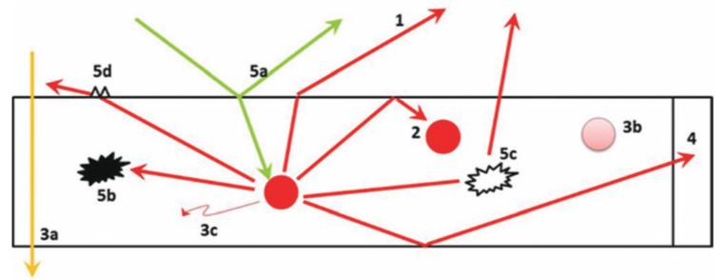
Why is such an apparently good idea a no-show on NREL's chart?
Because of its many inefficiencies, as identified in a recent comprehensive review: ¹
1) Emitted redish light from some Q-dots / Dyes is directed into angles escaping total internal reflection
2) Some emitted redish light is re-absorbed by other Q-dot / Dye's (the process IS reversed!)
3a) Some entering light misses all of the Q-dots / Dyes, passing straight through
3b) Some Q-dots / Dyes fail to absorb incoming light (e.g., due to chemical aging or "light bleeching")
3c) Some Q-dots / Dyes absorb incoming light but fail to re-emit redish light
4) Solar cells at ends of layer fail to convert all of incoming redish light energy into electrical power
5a) Some sunlight bounces right off the concentrator's top surface
5b & 5c) Some light is absorbed or scattered outward by impurities (same symbol used for such traps!)
5d) Some light fails to internally reflect due to roughness or flaws on surfaces of concentrator layer
1) "30 Years of Luminescent Solar Concentrator Research"
M.G.Debije & P.P.C. Verbunt, Advanced Energy Materials 2, pp. 12-35 (2012)

Slide 82
Result? LSC power conversion efficiencies of ~ 5% or less ¹
Then why bother with such an apparently complex but inefficient scheme?
Think a bit more about these thin flat stationary sheets
  They might ultimately be quite cheap as they consist of only:
    Thin transparent plastic sheets or films
    Having small added quantities of easy-to-make Q-dots or Dyes
    With tiny (e.g., 1 millimeter wide slivers) of PV cells facing their edges
  But even as flat stationary sheets they can capture light from lots of angles
    Directly from the shining sun AND/OR from the whole sky on overcast days
  Filtering out (often harmful) UV light, but passing through a lot of visible light
Figured out their potentially "golden" application?
1) "30 Years of Luminescent Solar Concentrator Research"
M.G.Debije & P.P.C. Verbunt, Advanced Energy Materials 2, pp. 12-35 (2012)

Slide 83
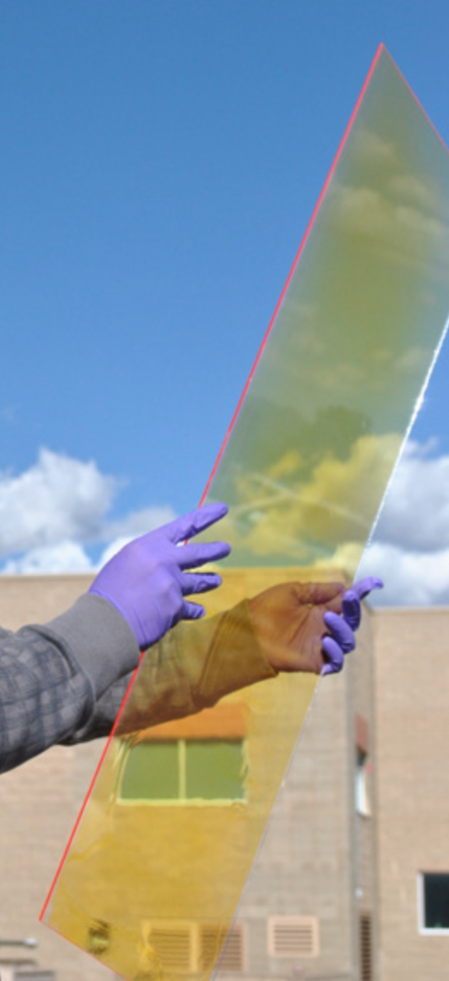
As windows in big urban office buildings and apartments:
Where they could provide at least some of the building's power
While blocking some sunlight of all colors
  as is now commonly done via semi-mirror coatings
Reducing the heat load to the building
  thereby reducing air-conditioning power expenditure
But especially blocking the UV end of the solar spectrum and its
  damage to plastics, rubbers, paints & pigments
And, by using liquid-crystal Dyes (re-orientable by voltage),
  light blocking in different parts of spectrum (IR / Vis / UV)
    might be controlled electronically and tailored
      to prevailing temperature & sunlight conditions ^{1,2}
LSC window from U.S.
Los Alamos National Lab ²
1) M.G.Debije & P.P.C. Verbunt, Advanced Energy Materials 2, pp. 12-35 (2012)
2) Li et al., Nature Energy 157, pp. 1-9 (2016)

Slide 84
How efficient are these LSC's?
The 2016 Los Alamos National Lab paper claims ¹
  10% internal quantum conversion efficiency
But a 10% quantum efficiency means only that within the device
  1 electron is liberated per 10 incoming solar photons
That is NOT the same as a 10% power conversion efficiency
  = Electrical Power Out / Solar Power In
For an LSC window, I'd think the figure-of-merit might be
  = Electrical Power Out / Blocked Solar Power In
  "Blocked" because windows NEED to pass a lot of light
I found no reports about this (or a comparable figure)
  and thus cannot yet assess the power potential of LSC's
Los Alamos
National Lab ¹
1) Li et al., Nature Energy 157, pp. 1-9 (2016)

Slide 85
Thermophotovoltaics
An Introduction to Sustainable Energy Systems: WeCanFigureThisOut.org/ENERGY/Energy_home.htm

Slide 86
Thermophotovoltaics
Thermophotovoltaics echo LSCs in that they seem to have come out of nowhere,
  they embody unusually obscure and exotic science,
    and they offer whole new sources of photovoltaic power
Thermophotovoltaics are all about heat - more often than not about waste heat
  Which our factories & engines produce in truly prodigious quantities:
    Fossil fuel power plants waste 60-70% of fuel energy as heat
      (for details, see my Fossil Fuels note set (pptx, pdf, key))
    Internal combustion engines waste almost 80% of fuel energy as heat
      (for details, see my Transportation note set (pptx, pdf, key))
Capturing even a small fraction of that waste heat
and converting it into electrical power could be a HUGE deal!

Slide 87

Heat is all about vibrating atoms
But vibrating atoms radiate away electromagnetic energy (a.k.a. "light")
Physicists characterize this radiation from heated objects by "Black Body" curves,
  which plot light intensity vs. wavelength (vs. the object's temperature):
6000°K
Light
Power
5000°K
4000°K
3000°K
100
500
1000
1500
2000
2500
Visible
Wavelength (nm)
Comparison with our sun's spectrum (at the right) shows that our sun emits energy
  like a 6000°K black body (which is indeed the temperature of the sun's surface)
(In a sense, this makes ALL photovoltaic devices thermophotovoltaic devices)

Slide 88
But these new thermophotovoltaics target cooler temperatures
Temperatures produced by our factories, by our motors, by our . . .
  At their hottest, these objects tend to glow from dark red to pale yellow,
    indicating temperatures of roughly 500 to 1000°C (~ 750 to 1250°K)
That's COLD by black body standards, producing very little light emission:
6000°K
Light
Power
5000°K
4000°K
3000°K
100
500
1000
1500
2000
2500
Visible
Wavelength (nm)
Indeed, the integrated power radiated from a black body (over all wavelengths)
  scales as that black body's temperature to the FOURTH POWER
(Which is known as the "Stefan-Boltzman Law")

Slide 89

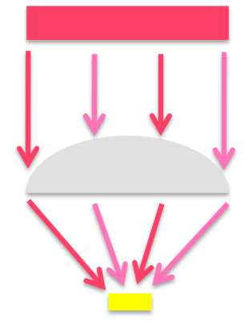
In response, thermophotovolatic schemes first try to jack up temperatures:
This can be done by concentrating the hot object's weak infrared emission
  using the same sort of mirrors or lenses we saw used with conventional PV:
Hot object:
Very hot PV cell:
But neither scheme is entirely satisfactory - for at least two reasons:
- PV cell's like intense light but need to stay cool themselves - cooling is thus required
- The PV cells still receive black body light which has a range of colors
  limiting them to low Shockley-Quisser power conversion efficiencies

Slide 90
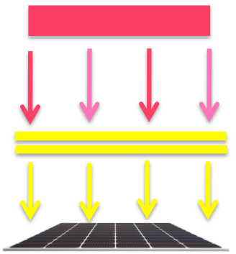
Here's where thermophotovolatics pull out all of the (scientific) stops:
The thermophotovoltaic converter is built in flat layers
  If flexible and thin, it might even be wrapped around the heat-wasting hot object
The hot object's mixed infrared radiation strikes a two-layer absorber / emitter
The top absorber layer captures essentially ALL of that incoming energy
  But, magically, it does NOT then radiate energy back outward - as black bodies should!
    Which means that the absorber soon becomes VERY HOT
      Indeed, hotter than the hot object from which it gathered its energy
It transfers energy ONLY to the attached emitter layer which magically radiates
  one pure PV pleasing (Shockley-Quiesser subverting) color to the PV cell below

Slide 91
The source of that magic? Metamaterials
A material's properties are determined by the atomic structure nature built into it
But metamaterials incorporate very un-natural manmade structures
  Which, if built cleverly, have properties NOT found in nature ¹
Metamaterials can take many, many forms
  Ranging from 2D SiGe strained-layer "superlattices" I pioneered at Bell Labs ²
  To 3D Photonic Crystals ³ assembled by microfabrication ⁴
  To dense arrays of carbon nanotubes created via nanoscale self-assembly ⁵
1) Review Article: Metamaterials in Electromagnetics,"Ari Sihvola, Metamaterials 1, pp.2-11 (2007)
2) Review Article: Silicon Based Semiconductor Heterostructures: Column IV Bandgap Engineering, John C. Bean, Proceedings of the IEEE 80 (4), pp. 571-587 (1992)
3) Photonic Band-Gap Crystals, Eli Yablonovitch, J. Physics of Condensed Matter 5, pp. 2243-60 (1993)
4) See my Nanoscience class note set on Microfabrication / Micromachining (pptx / pdf / key)
5) See my Nanoscience class note set on The Need for Self-Assembly (pptx / pdf / key)

Slide 92
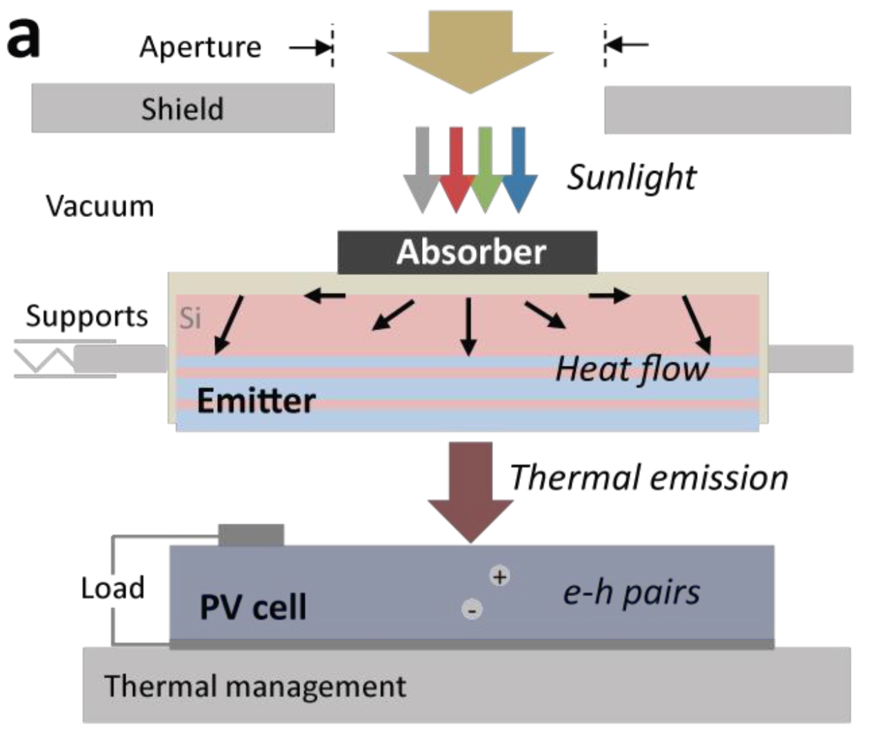
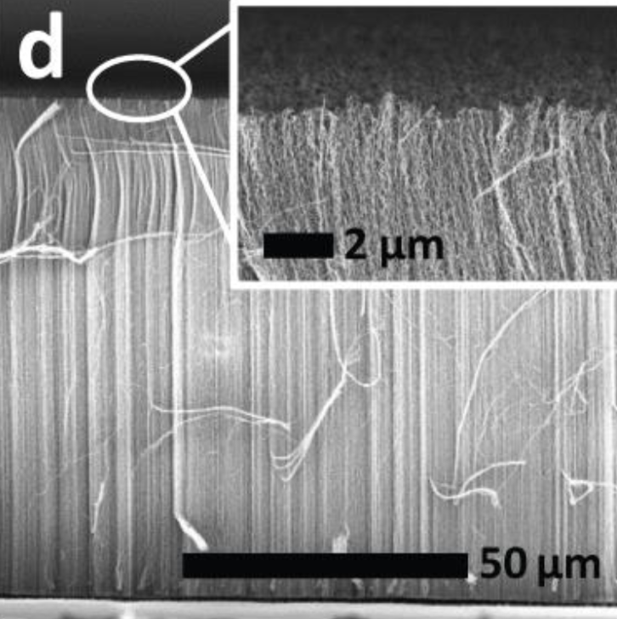
One way of applying metamaterial magic to thermophotovoltaics: ¹
The absorber traps the heated object's light
in an array of nanometer thick carbon nanotubes:
The carbon nanotube array resembles a brush with very widely spaced bristles
  The wide nanotube spacing slashes light reflection from the array's surface
Simultaneously, the carbon nanotube's exceptionally conductivity boosts light absorption
  Together these yield a near perfect, angle-independent, light absorber ^{2, 3}
1) A Nanophotonic Solar Thermophotovoltaic Device, Lenert et al., Nature Nanotechnology 9 (2), pp. 126-30 (2014)
2) Experimental Observation of an Extremely Dark Material made by a Low-density Nanotube Array, Yang et al,. Nano Letters 8 (2), pp. 446-51 (2008)
4) Effective Medium Theory of the Optical Properties of Aligned Carbon Nanotubes, Garcia-Vidal et al., Phys Rev Lett 78(22), pp. 4289-92 (1997)

Slide 93
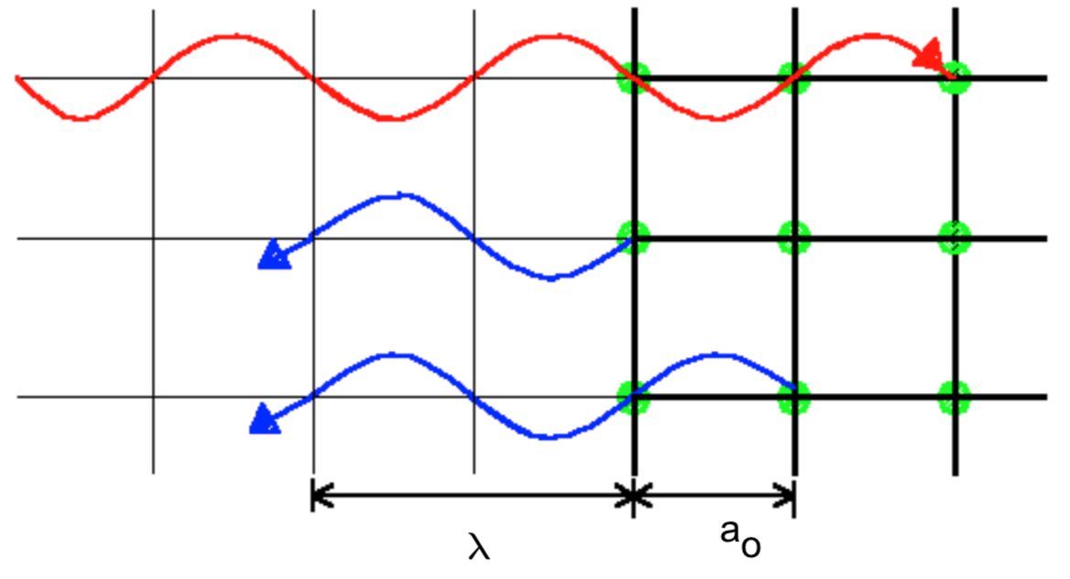
The absorber thus heats up dramatically
As a black body, that absorber should then increasingly radiate away power
  Further, that radiation should include a black body's typical span of colors
But in this device, radiation is blocked (& filtered) by Photonic Crystal metamaterials
In natural crystals, waves can slightly reflect off consecutive atomic planes
  When those reflections are "in phase" they interfere constructively
  And net reflection increases until the wave can no longer propagate forward:
This occurs when wavelength = 2 ao / n where n = 1, 2, 3 . . .
(where ao denotes the spacing between the atomic planes)

Slide 94
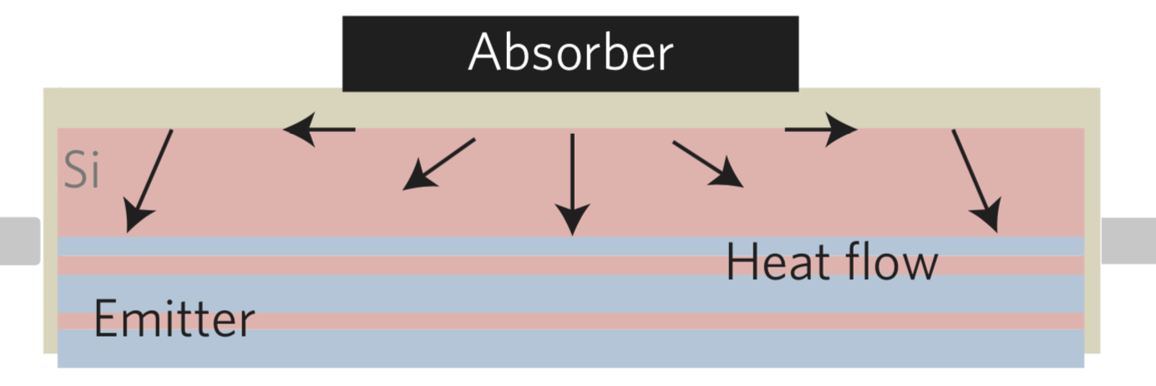
Photonic Crystals do the same thing at larger scales ^{1, 2}
By simply exchanging atoms for layers or arrays of larger manmade objects,
  which are defined by the same microfabrication techniques
    originally developed for the integrated circuit industry
<= Photonic Crystal
THIS crystal is designed to reflect back (and thus trap) MOST wavelengths of light
  Its wavelength-blocking span might be enhanced, for instance,
    by stacking Photonic Crystals with different layer / array spacings
But it ALLOWS a narrow range of wavelengths (= colors) to continue downward
1) Photonic Band-Gap Crystals, Eli Yablonovitch, J. Physics of Condensed Matter 5, pp. 2243-60 (1993)
2) Photonic Crystals in the Optical Regime - Past, Present and Future, Kraus & de la Rue, Progress in Quantum Electronics 23, pp. 51-96 (1999)

Slide 95
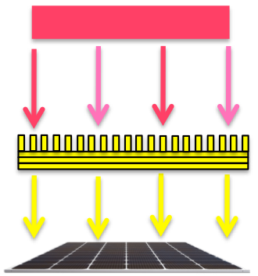
Only that almost-single-color light reaches the PV cell below:
Equals:
But - importantly! - that now almost single color of light ends up carrying forward
  essentially all of the energy that left the bottom face of the hot object
The PV cell's bandgap can thus be tailored to that almost single color,
  which virtually eliminates liberated electron "butt-kicking,"
    allowing that PV cell to shatter the Shockley-Quiesser efficiency limit
At least that's the plan

Slide 96
How well are actual thermophotovoltaic devices doing?
For the 2014 MIT device, above, power conversion efficiency of 3.2% was reported ¹
  Claimed to be a notably improvement upon then prevailing efficiencies of ~ 1%
    But far short of cited theoretical limits of of ~ 40% ²⁻⁴
What has happened since that 2014 publication?
  An early review reported prototypes with efficiencies reaching 11% ⁵
  But in 2018 a team including Sandia National and MIT Lincoln Lab members
    claimed a power conversion efficiency of 24.1% ⁶
= Very respectable / rapidly improving TPV power conversion efficiencies
1) A Nanophotonic Solar Thermophotovoltaic Device, Lenert et al., Nature Nanotechnology 9 (2), pp. 126-30 (2014)
2) Absorber and Emitter for Solar Thermo-photovoltaic Systems to Achieve Efficiency Exceeding the Shockley-Queisser Limit, Rephaeli et al., Optics Express 17(7), 15145 (2009)
3) Design and Global Optimization of High-efficiency Thermophotovoltaic Systems, Bermel et al., Optics Express 18(S3), A314 (2010)
4) Metamaterial-based Integrated Plasmonic Absorber/Emitter for Solar Thermo-Photovoltaic Systems, Wu et al., J. Optics 14, pp. 1-7 (2012)
5) Overview and Status of Thermophotovoltaic Systems, Ferrari et al., Energy Proceedia 45, pp. 160-9 (2014)
6) High-efficiency Thermophotovoltaic Energy Conversion Enabled by a Metamaterial Selective Emitter, Woolf et al., Optica 5(2), pp.213 (2018)

Slide 97
A postscript concerning Metamaterials:
The preceding discussion of metamaterials may puzzle some readers,
  as it corresponds only weakly with results you might get from a Google search
Why? Because there are TWO commonly accepted definitions of metamaterials
The broad definition (which I employed):
  Manmade artificially structured materials with properties not found in nature
The narrow definition (popular within one particular research community):
  Manmade artificially structured materials that subvert Maxwell's Equations
Explanation: Electricity & Magnetism were explored throughout the 1700's and 1800's
  With observations spawning literally dozens of different "Laws"
    But in the mid-1800's, James Clerk Maxwell managed to unify all of those laws
      into just four (decidedly not simple) coupled equations which ~ completely
        describe the behavior of Electric (E) and Magnetic (B) fields ^{1, 2}
1) For details see my note set: Electric and Magnetic Fields (pptx / pdf / key) and its Resources webpage (link)
2) For details see my note set: Magnetic Induction (pptx / pdf / key) and its Resources webpage (link)

Slide 98
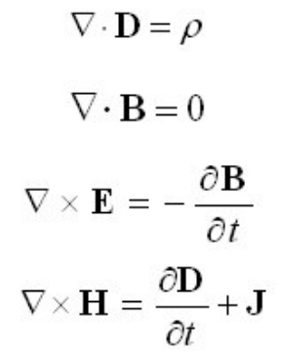
Maxwell's Equations (as applied within a material):
E = Electric Field D = ε E
e = Material's "Permittivity"
B = Magnetic Field H = μ B
m = Material's "Permeability"
    ρ = Electrical charge / volume J = The flow of that charge
    e and m capture how the material reacts to applied electric or magnetic fields
    In sensibly acting natural materials, both are positive numbers
    But what if artificial alteration of material structure made one or both negative?
    The weirdness this would produce, and how to drive ε and/or μ negative,
    are the focus of the other (narrower) definition of metamaterials ¹
    But negative values have only yet been achieved at "microwave" sublight frequencies
    Making those "metamaterials" irrelevant (so far) to photovoltaic power conversion
1) See: Introduction to Metamaterials, Wartak et al., Physics in Canada 67 (1), pp. 30-34 (2011)

Slide 99
Credits / Acknowledgements
Some materials used in this class were developed under a National Science Foundation "Research Initiation Grant in Engineering Education" (RIGEE).
Other materials, including the "Virtual Lab" science education website, were developed under even earlier NSF "Course, Curriculum and Laboratory Improvement" (CCLI) and "Nanoscience Undergraduate Education" (NUE) awards.
This set of notes was authored by John C. Bean who also created all figures not explicitly credited above.
Copyright John C. Bean
(However, permission is granted for use by individual instructors in non-profit academic institutions)
An Introduction to Sustainable Energy Systems: WeCanFigureThisOut.org/ENERGY/Energy_home.htm

